Slide 1
Large scale building damage assessment on satellite images

Slide 2
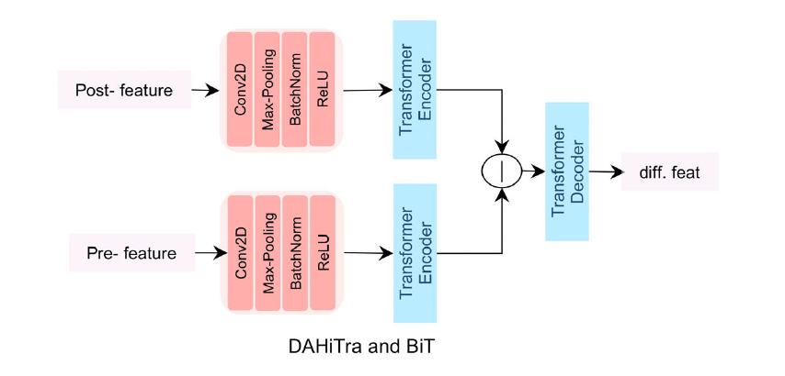
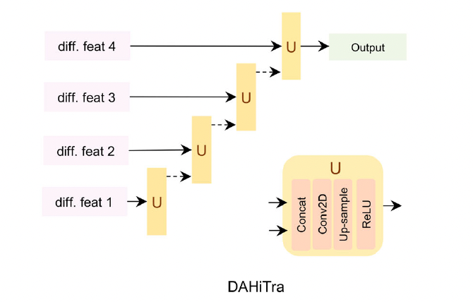
DAHiTra architecture

Slide 3
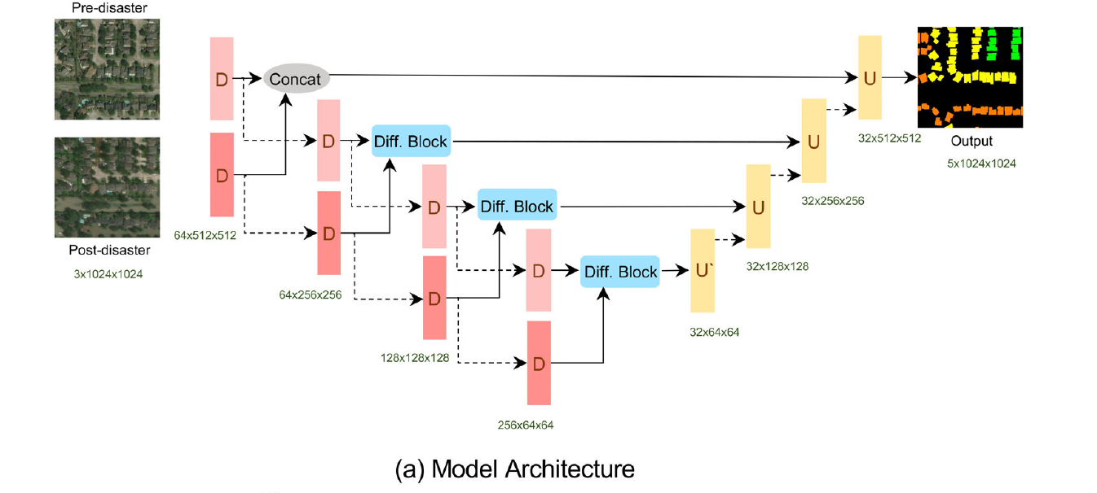

Slide 4
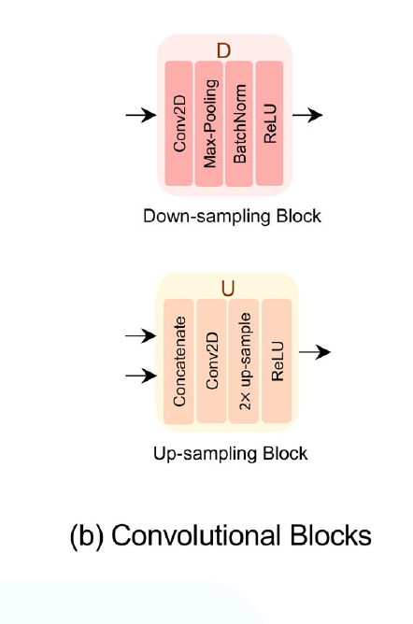
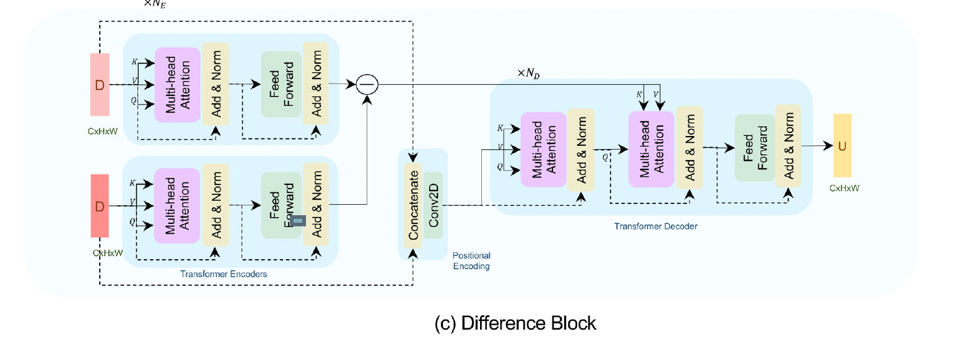

Slide 5
HOW THIS ARCHITecture works?
A pair of predisaster and postdisaster images is fed into an encoder made up of stacked convolution blocks (red layers), where each convolutional block downsamples the feature space (dashed lines).
The output from each block of pre- and postdisaster image encoders is passed jointly (solid lines) into the difference block, which maps the spatial features into the feature domain and then takes the difference followed by a transformer decoder to map the features back into the spatial domain.
Next, the output mask is hierarchically built by up-sampling (dashed lines) and concatenating the features from lower dimension to higher dimension layers.

Slide 6
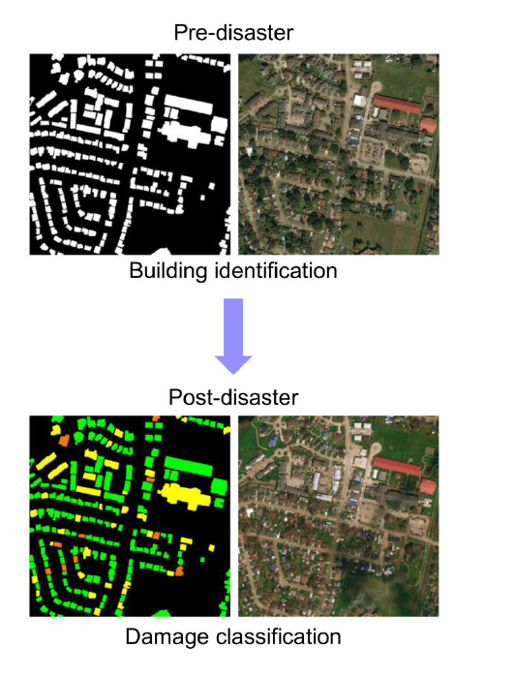
PRE disaster masking vs post disaster masking

